Slide 1
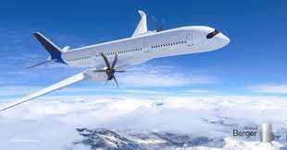
Indian Airlines Ticket Price Analysis

Slide 2
Objective
In aviation industry the ticket price plays an important as far as business concern . And the ticket price rely on different factors . we did analysis and found some insights .

Slide 3
About the dataset
This dataset include details of ticket price and different airline and their class and the number of flights .
Various features of clean dataset are given below .
Airline : The airline column contains the name of the airline firm. There are six different airlines .
Flight : The flight code of the aircraft is stored in flight.
Source City : City where the flight departs from is a classification feature with 6 distinctive cities.
Departure Time: It has six different time labels and stores information about the departure time.
Stops: A category feature that holds the number of stops between the source and destination cities .
Arrival Time: It provide information regarding the arrival time and has six different time labels.
Destination City: The location of the aircraft's landing. It is a classification feature with 6 distinctive cities.
Class: It explain the class of Airline . Its has two different values .
Duration: A permanent feature that shows the total number of hours needed to travel between cities.
Price: Information about the ticket price is stored in price column .

Slide 4
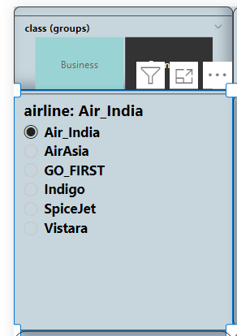
Exploratory Data Analysis
Total Number of Airline and total number of Flights –
There are two class of Airlines . And there are six types of Airlines . And 300 K total number of flights .Vistara has highest number of flights at 67 K

Slide 5
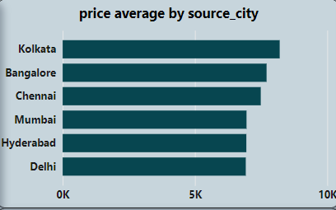
Price average by source city
﻿At 8,201.98, Kolkata had the highest price average and was 18.52% higher than Delhi, which had the lowest price average at 6,920.23.﻿﻿ ﻿﻿﻿﻿ ﻿﻿Across all 6 source_city , price average ranged from 6,920.23 to 8,201.98.﻿﻿ ﻿﻿ ﻿

Slide 6
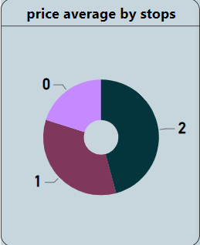
Price average by stop
2 had the highest price average at 10,841.42, followed by 1 at 7,296.66 and 0 at 4,062.09.﻿﻿ ﻿

Slide 7
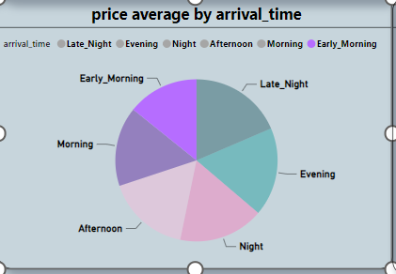
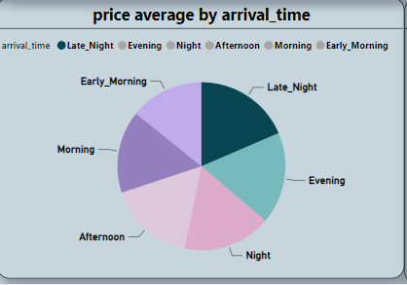


Price average by Arrival time
Late night had the highest price average at 8,109.67 where as early morning had the lowest price average at 6,217.62 .

Slide 8
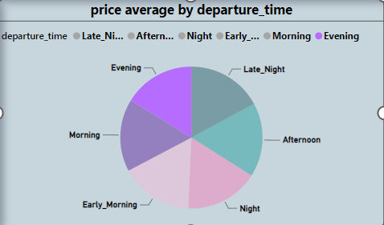
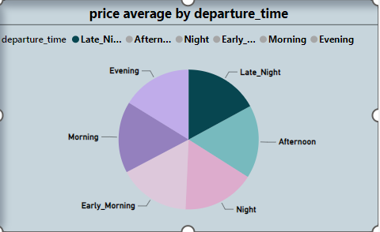


Price average by departure time
Late night had the highest price average at 7,544.45 , where as evening had the lowest price average at 7,159.62

Slide 9
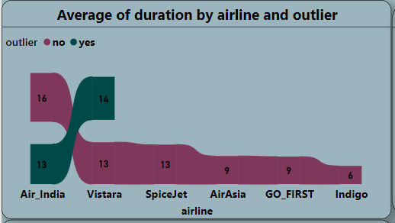
0utlier –
﻿Air_India in outlier made up 16.98% of Average of duration.﻿﻿ ﻿﻿ ﻿ Average of duration was higher for yes (13.21) than no (10.82).﻿﻿ ﻿﻿ ﻿﻿Average of duration for no and yes diverged the most when the airline was Air_India, when no were 2.78 higher than yes.﻿﻿ ﻿﻿ ﻿

Slide 10
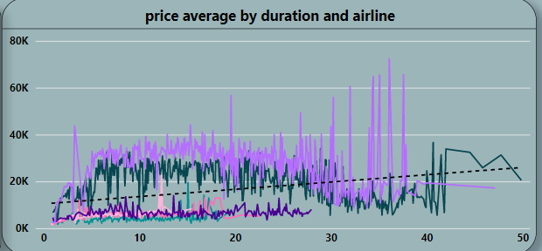
Price average by duration and airline
36.08 in airline made up 0.30% of price average.﻿﻿ ﻿ Vistara is leading in price average as per duration and as comparison to other airline .

Slide 11
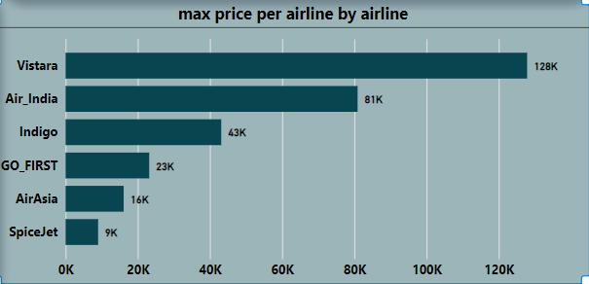
Max Price per airline
﻿At 127859.00, Vistara had the highest max price per airline and was 1,318.92% higher than SpiceJet, which had the lowest max price per airline at 9011.00.﻿﻿ ﻿﻿ ﻿﻿[]﻿﻿ ﻿﻿ ﻿﻿Across all 6 airline, max price per airline ranged from 9011.00 to 127859.00.﻿﻿ ﻿﻿ ﻿

Slide 12
Conclusion
Air Asia' offers the cheapest flight tickets .
Flight prices increase with increase in number of stops.
Ticket price is lower as the source city is Delhi but highest price ticket when source city is Kolkata .
Arrival late night had the highest price ticket and Arrival early morning had the lowest price ticket .
Departure late night had the highest price ticket and departure evening had the lowest price ticket .
Average of duration for no and yes diverged the most when the airline was Air_India .
As per the duration price increases but Vistara is leading in price average as per duration and as comparison to other airline .

